Slide 1
MATH-352 Numerical Methods
Atifa Kanwal
atifa.kanwal@seecs.edu.pk
Office # 303, Faculty Block, SEECS, NUST

Slide 2
Books
Numerical Methods for Engineers by Steven C. Chapra, Rymond P. Canale.
Numerical Methods by J. Gouglas Faires, Richard Burden
Applied Numerical Analysis by Curtis F. Gerald, Patrick O. Wheatley
Advance Engineering Mathematics by Erwin Kreyszig

Slide 3
In this Course, we will study
Introduction: Error calculation and Taylor Series
Methods of Solution of Nonlinear/Transcendental Equations
Bracketing Methods
Bisection Method
False Position Method
Open Methods
Newton Raphson Method
Secant Method

Slide 4
Iterative Methods of Solution of System of Linear Equations
Gauss-Seidel Method
Jacobi’s Method
Method of least squares
Gauss Elimination Method
LU Factorization

Slide 5
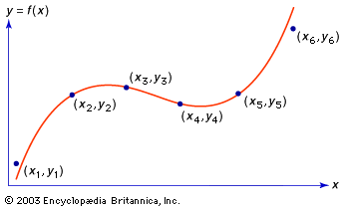
Interpolation
Calculus of Finite Difference and Difference Operators
Lagrange interpolation formula.
Newton’s divided difference interpolation formula.
Newton’s forward and backward difference interpolation formula.
Error Analysis and Comparison of methods of Interpolation
Introduction of splines, cubic splines, curve fitting

Slide 6
Numerical Differentiation
Differentiation using Interpolation Techniques
Differentiation using Taylor Series
Numerical Integration
Newton-Cotes Integration Formulas
Trapezoidal Rule
Simpson’s 1/3 Rule
Simpson’s 3/8 Rule

Slide 7
Numerical Solutions of Ordinary Differential Equations
Euler’s method
Modified Euler’s Method
Runge-Kutta Methods
Application of Numerical Techniques for ODE’s

Slide 8
Evaluation Criterian
Theory: 75%
Lab:25%
Total :100%
Theory(100%)
Lab Work(100%)
2 or 3 Quizzes: 10 %
2 Assignments + class performance:10%
MSE: 30%
ESE: 50%
Min 12 Labs :70 – 75%
Final Exam/Project:
25-30%
To appear in ESE minimum 75 % attendance is required.

Slide 9
You can contact me
In my office A-303, Faculty Block, SEECS.
Through email, atifa.kanwal@seecs.edu.pk

